Slide 1
Medical Image Segmentation based on DenseNet
RESEARCH SEMINAR PROJECT
PROFESSOR:
JUAN SHAN
BY:
MOHAMMAD
KRISHNA

Slide 2
SKIN cancer Melanoma segmentation
The most prevalent form of cancer in US is skin cancer.
Domain experts visual inspection accuracy is only 60%.
Dermoscopic Accuracy is 75-84%
Lack of Dermatologist against growing cases.

Slide 3
OBJECTIVE
Melanoma segmentation
Analysis for task-1 is segmentation, task-2 dermoscopic feature detection, and task-3 classification.
the goal of the project is task1 to determine the segmentation of lesion analysis.

Slide 4
Melanoma segmentation
DATASET
The International Skin Imaging Collaboration (ISIC) has large-scale publicly accessible dataset of dermoscopic images.
Location: http://challenge2017.isic-archive.com/

Slide 5
Evaluation metrics
images
Training : 2000
Validation : 150
Test : 600
IOU :

Slide 6
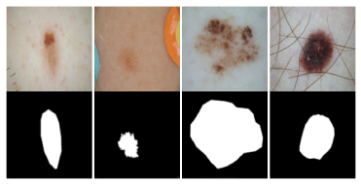
Literature review
LESION TASKS:
Segmentation :
Automated predictions of lesion segmentations from dermoscopic images in the form of binary masks

Slide 7
ANALYSIS
LESION TASKS:
Segmentation :
Pixel values
255 = Inside Area of Lesion
0 = Outside Lesion

Slide 8
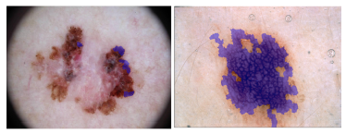
ANALYSIS
LESION TASKS:
2. Dermascopic Feature Classification:
Detection of Network, Negative Network, Streaks and Cysts.

Slide 9
ANALYSIS
LESION TASKS:
2. Dermascopic Feature Classification:
Pattern Detection with Localization
Lesion images subdivided in to Superpixels
Lesion image and corresponding set of Superpixel masks.

Slide 10
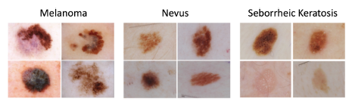
ANALYSIS
LESION TASKS:
Disease Classification:
Classify one of the three categories.

Slide 11
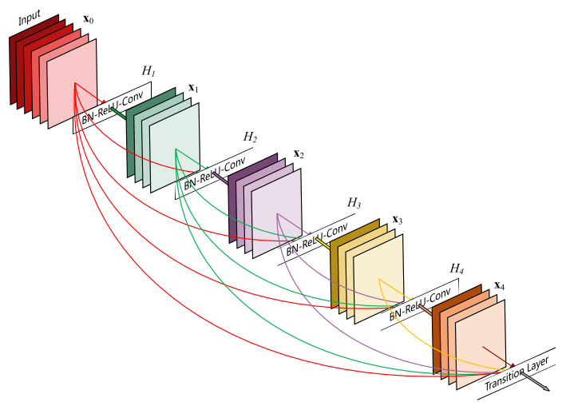
METHODOLOGY
Architecture of the Network block
A 5-layer dense block with a growth rate of k = 4.
Each layer takes all preceding feature-maps as input

Slide 12
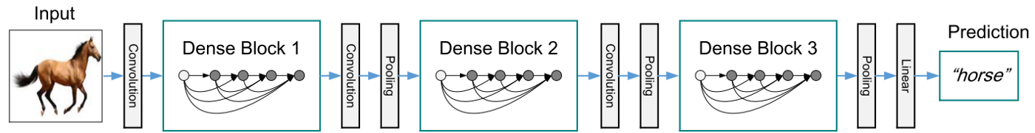
METHODOLOGY
Architecture of the Network block
A deep DenseNet with three dense blocks. The layers between two adjacent blocks are referred to as transition layers and change feature-map sizes via convolution and pooling.

Slide 13
Advantages of denseNet
DenseNeT – A Residual Network architecture
Advantages:
- alleviate the vanishing-gradient problem
- substantially reduce the number of parameter.
- encourage feature reuse.

Slide 14
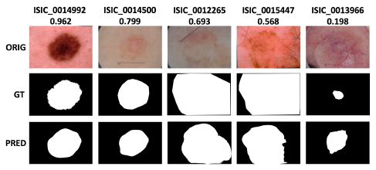
Related work
SEGMENTATION

Slide 15
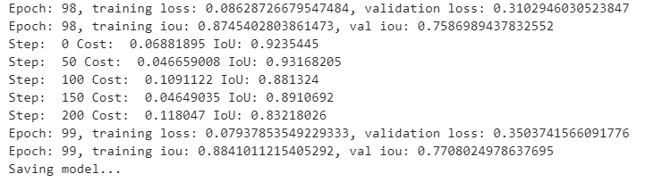
RESULTS dense-net

Slide 16
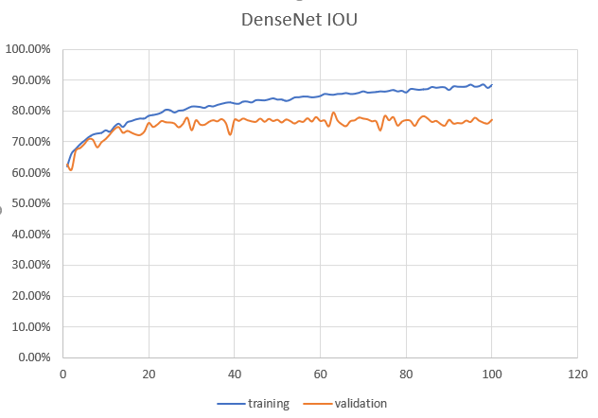
RESULTS dense-net

Slide 17
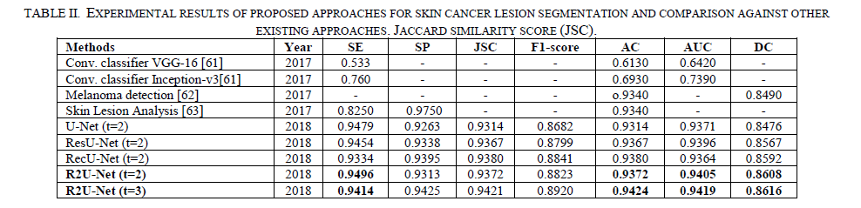
Related works

Slide 18
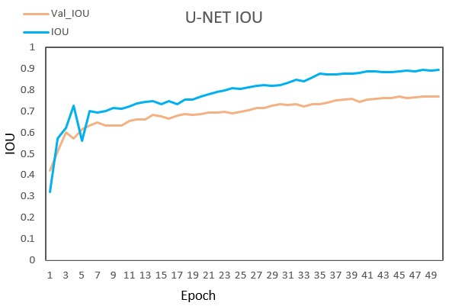
RESULTS u-net

Slide 19
Thank You

